Slide 1

Reactive Extensions

Slide 2
Reactive Extensions
Qu’est ce que c’est ?

Slide 3

Itérateur asynchrone

Slide 4
Itérateur asynchrone

Slide 5
Itérateur
Fournisseur
Client

Slide 6
Itérateur
Fournisseur
Client
next()

Slide 7
Itérateur
Fournisseur
Client
next()
return

Slide 8
Itérateur
Fournisseur
Client
next()
return
next()

Slide 9
Itérateur
Fournisseur
Client
next()
return
next()
return

Slide 10
Itérateur
Fournisseur
Client
next()
return
next()
return
next()

Slide 11
Itérateur
Fournisseur
Client
next()
return
next()
return
next()
return

Slide 12
Itérateur
synchrone
Fournisseur
Client
next()
return
blocage…
next()
blocage…
return
next()
return
blocage…

Slide 13
Itérateur
asynchrone
Fournisseur
Client

Slide 14
Itérateur
asynchrone
Fournisseur
Client
subscribe()

Slide 15
Itérateur
asynchrone
Fournisseur
Client
subscribe()
onNext()

Slide 16
Itérateur
asynchrone
Fournisseur
Client
subscribe()
onNext()
onNext()

Slide 17
Itérateur
asynchrone
Fournisseur
Client
subscribe()
onNext()
onNext()
onNext()

Slide 18
Itérateur
asynchrone
Fournisseur
Client
subscribe()
onNext()
blocage…
onNext()
blocage…
onNext()

Slide 19
Itérateur
asynchrone
Observable
Observer
subscribe()
onNext()
onNext()
onNext()

Slide 20

Iterator, Observer ?

Slide 21


Slide 22
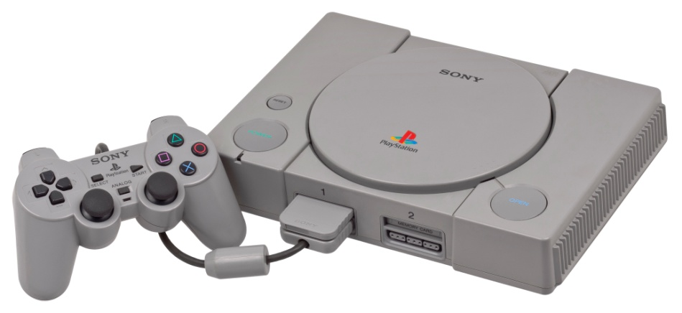
1994

Slide 23


Iterator
Fournisseur
Client
Observer

Slide 24
Iterator
PULL
Fournisseur
Client
PUSH
Observer

Slide 25
Iterator
Observer
T next()
onNext(T)
throws Exception()
onError(Exception)
!hasNext()
onCompleted()

Slide 26
Un exemple ?

Slide 27
List<String> names = {Bruce, Peter, Clark}
Observable.from(names).subscribe(
new Action1<String>() {
public void call(String s) {
System.out.println("Hello " + s + "!");
}
});
> Hello Bruce !
> Hello Peter !
> Hello Clark !

Slide 28
List<String> names = {Bruce, Peter, Clark}
Observable.from(names).subscribe(
new Action1<String>() {
public void call(String s) {
System.out.println("Hello " + s + "!");
}
});
Créé un Observable
> Hello Bruce !
> Hello Peter !
> Hello Clark !

Slide 29
List<String> names = {Bruce, Peter, Clark}
Observable.from(names).subscribe(
new Action1<String>() {
public void call(String s) {
System.out.println("Hello " + s + "!");
}
});
Ceci est un Observer
> Hello Bruce !
> Hello Peter !
> Hello Clark !

Slide 30
List<String> names = {Bruce, Peter, Clark}
Observable.from(names).subscribe(
new Action1<String>() {
public void call(String s) {
System.out.println("Hello " + s + "!");
}
});
> Hello Bruce !
> Hello Peter !
> Hello Clark !

Slide 31
Names
List<String> names = {Bruce, Peter, Clark}
Observable.from(names).subscribe(
new Action1<String>() {
public void call(String s) {
System.out.println("Hello " + s + "!");
}
});
> Hello Bruce !
> Hello Peter !
> Hello Clark !

Slide 32
Names
Print()
List<String> names = {Bruce, Peter, Clark}
Observable.from(names).subscribe(
new Action1<String>() {
public void call(String s) {
System.out.println("Hello " + s + "!");
}
});
> Hello Bruce !
> Hello Peter !
> Hello Clark !

Slide 33
Names
Print()
List<String> names = {Bruce, Peter, Clark}
Observable.from(names).subscribe(
new Action1<String>() {
public void call(String s) {
System.out.println("Hello " + s + "!");
}
});
> Hello Bruce !
> Hello Peter !
> Hello Clark !

Slide 34
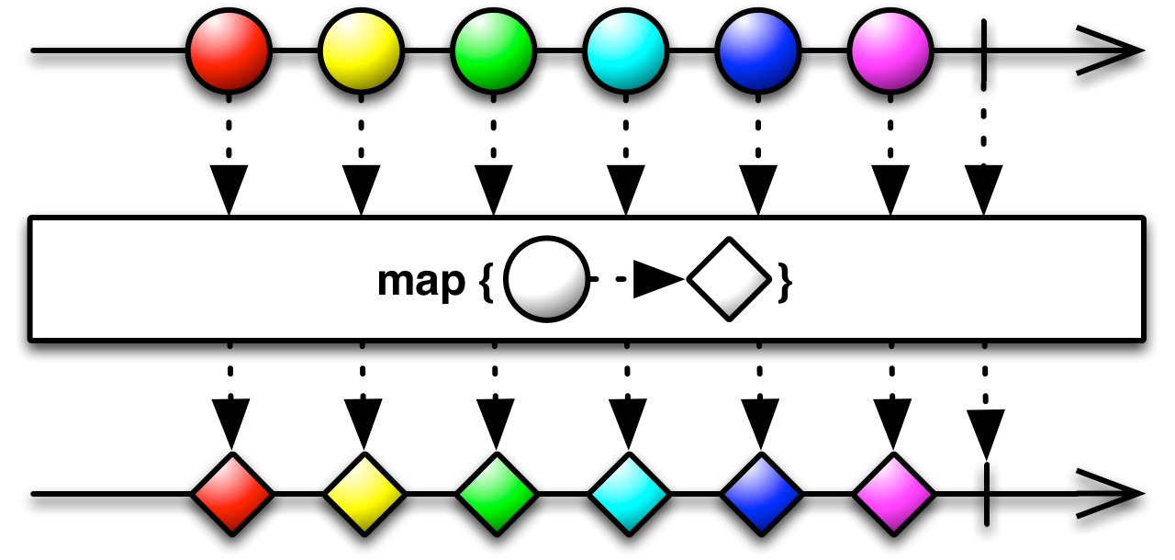
Map

Slide 35
Names
GetIdentity()
Print()
List<String> names = {Bruce, Peter, Clark}
Observable.from(names)
.map(
new Func1<String, String>(){
public String call(String name) {
return NSAService.getIdentity(name);
}
})
.subscribe(
(s) -> {System.out.println("Hello " + s + "!");}
);
> Hello Hulk !
> Hello Spiderman !
> Hello Superman !

Slide 36
Names
GetIdentity()
Print()
List<String> names = {Bruce, Peter, Clark}
Observable.from(names)
.map(
new Func1<String, String>(){
public String call(String name) {
return NSAService.getIdentity(name);
}
})
.subscribe(
(s) -> {System.out.println("Hello " + s + "!");}
);
lambda Java 8
> Hello Hulk !
> Hello Spiderman !
> Hello Superman !

Slide 37
Names
GetIdentity()
Print()
List<String> names = {Bruce, Peter, Clark}
Observable.from(names)
.map(
(name) -> {return NSAService.getIdentity(name);}
)
.subscribe(
(s) -> {System.out.println("Hello " + s + "!");}
);
lambda Java 8
> Hello Hulk !
> Hello Spiderman !
> Hello Superman !

Slide 38
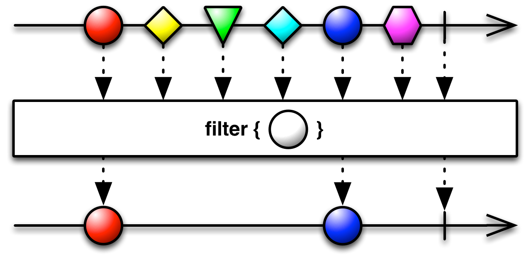
Filter

Slide 39
Names
GetIdentity()
isAnAvenger()
Print()
List<String> names = {Bruce, Peter, Clark}
Observable.from(names)
.map(
(name) -> {return NSAService.getIdentity(name);}
)
.filter(
(hero) -> {return Avengers.contains(hero);}
)
.subscribe(
(s) -> {System.out.println("Hello " + s + "!");}
);
> Hello Hulk !
> Hello Spiderman !

Slide 40
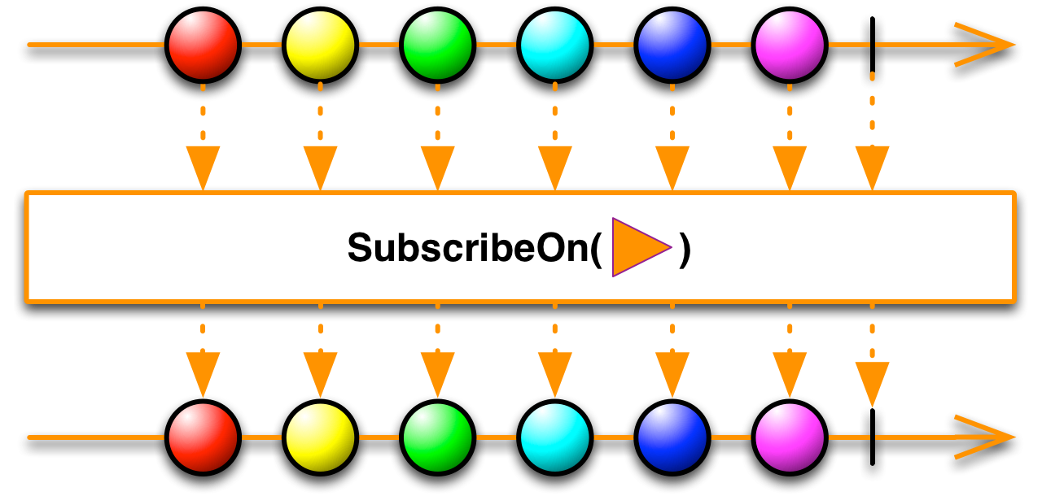
SubscribeOn

Slide 41
Names
GetIdentity()
isAnAvenger()
Print()
List<String> names = {Bruce, Peter, Clark}
Observable.from(names)
.subscribeOn(Schedulers.newThread())
.map(
(name) -> {return NSAService.getIdentity(name);}
)
.filter(
(hero) -> {return Avengers.contains(hero);}
)
.subscribe(
(s) -> {System.out.println("Hello " + s + "!");}
);
> Hello Spiderman !
> Hello Hulk !
> Hello Hulk !
> Hello Spiderman !

Slide 42
Names
GetIdentity()
isAnAvenger()
Print()
List<String> names = {Bruce, Peter, Clark}
Observable.from(names)
.subscribeOn(Schedulers.computation())
.map(
(name) -> {return NSAService.getIdentity(name);}
)
.filter(
(hero) -> {return Avengers.contains(hero);}
)
.subscribe(
(s) -> {System.out.println("Hello " + s + "!");}
);
> Hello Spiderman !
> Hello Hulk !
> Hello Hulk !
> Hello Spiderman !

Slide 43
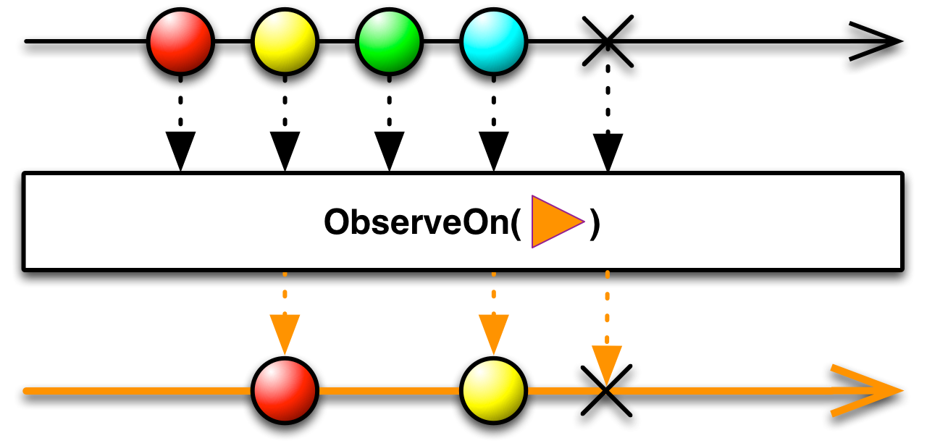
ObserveOn

Slide 44
Names
GetIdentity()
isAnAvenger()
Print()
List<String> names = {Bruce, Peter, Clark}
Observable.from(names)
.subscribeOn(Schedulers.computation())
.map(
(name) -> {return NSAService.getIdentity(name);}
)
.filter(
(hero) -> {return Avengers.contains(hero);}
)
.subscribe(
(s) -> {androidListView.getModel().addElement(s);}
);

Slide 45
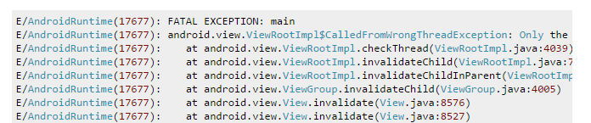
Names
GetIdentity()
isAnAvenger()
Print()
List<String> names = {Bruce, Peter, Clark}
Observable.from(names)
.subscribeOn(Schedulers.computation())
.map(
(name) -> {return NSAService.getIdentity(name);}
)
.filter(
(hero) -> {return Avengers.contains(hero);}
)
.subscribe(
(s) -> {androidListView.getModel().addElement(s);}
);

Slide 46
Names
GetIdentity()
isAnAvenger()
Print()
List<String> names = {Bruce, Peter, Clark}
Observable.from(names)
.subscribeOn(Schedulers.computation())
.map(
(name) -> {return NSAService.getIdentity(name);}
)
.filter(
(hero) -> {return Avengers.contains(hero);}
)
.observeOn(AndroidSchedulers.mainThread())
.subscribe(
(s) -> {androidListView.getModel().addElement(s);}
);

Slide 47
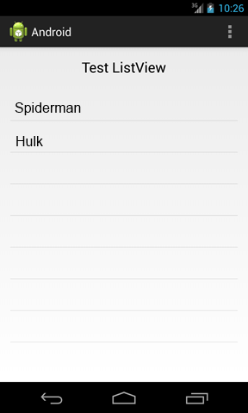
Names
GetIdentity()
isAnAvenger()
Print()
List<String> names = {Bruce, Peter, Clark}
Observable.from(names)
.subscribeOn(Schedulers.computation())
.map(
(name) -> {return NSAService.getIdentity(name);}
)
.filter(
(hero) -> {return Avengers.contains(hero);}
)
.observeOn(AndroidSchedulers.mainThread())
.subscribe(
(s) -> {androidListView.getModel().addElement(s);}
);

Slide 48
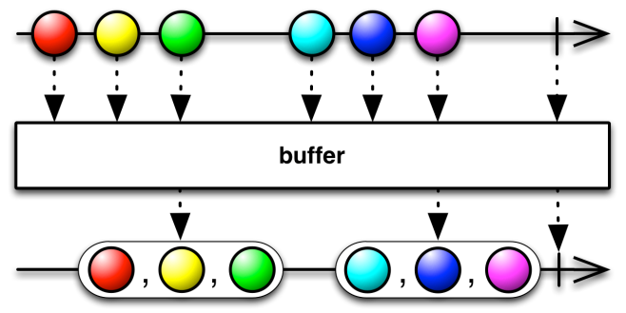
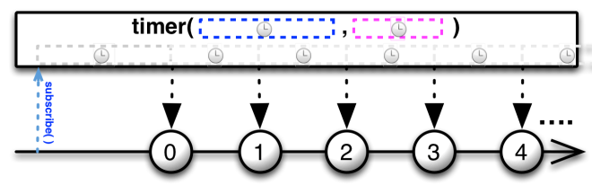
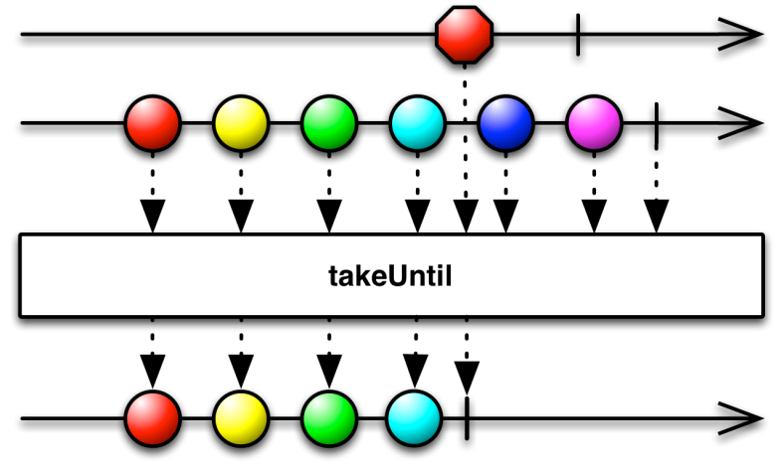
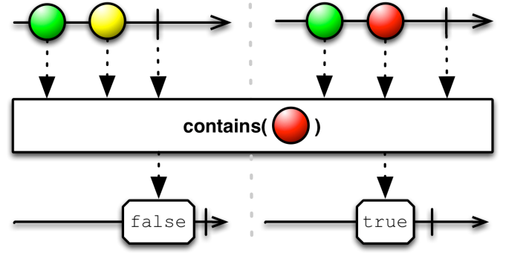
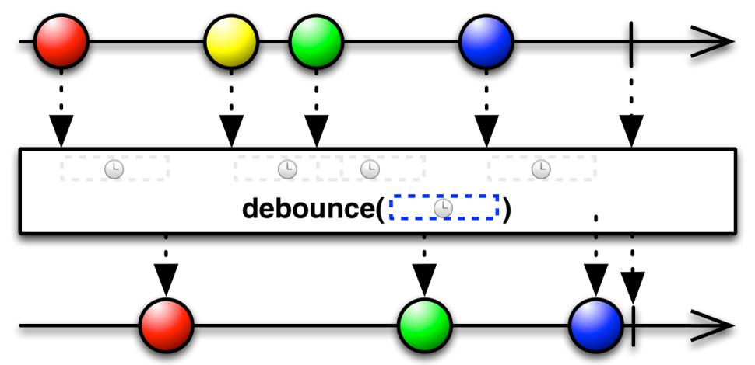
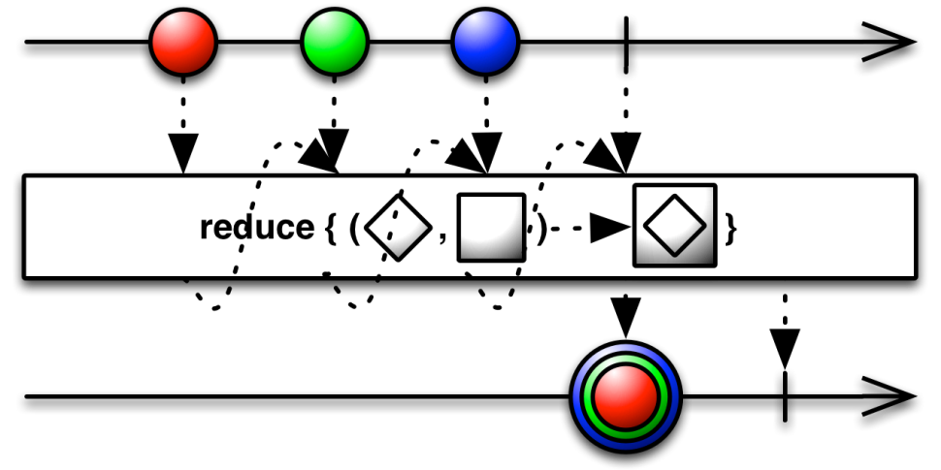
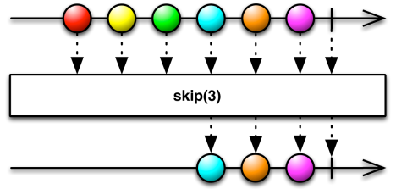

Slide 49


Slide 50

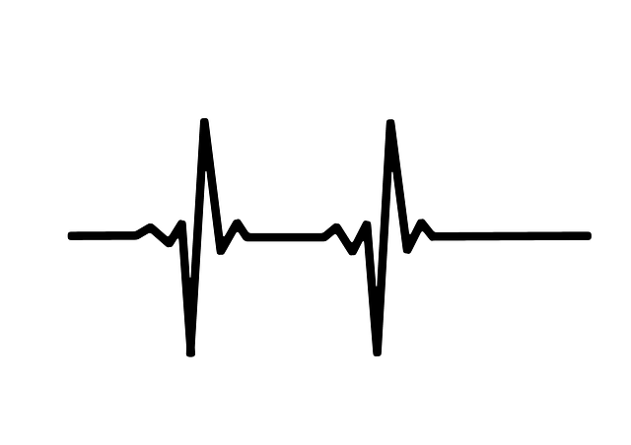



Sensor
Network Emitter
Network Receiver
GUI

Slide 51
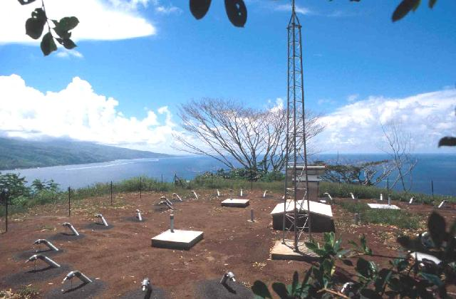

Slide 52
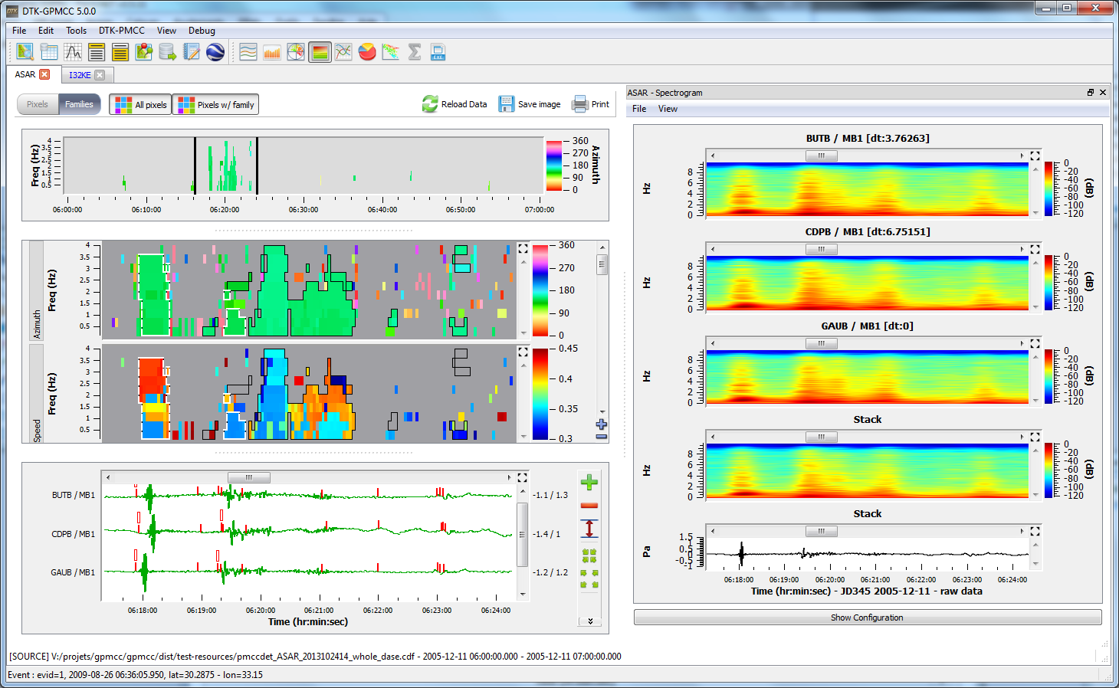

Slide 53


Slide 54
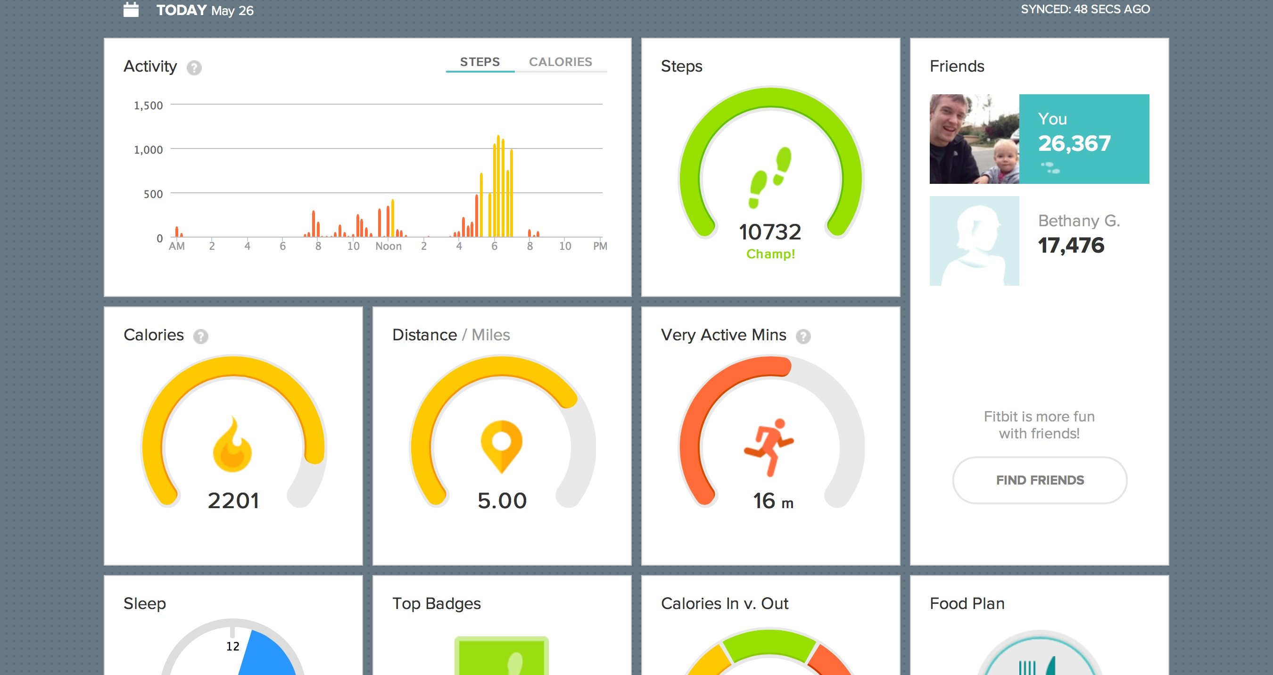

Slide 55
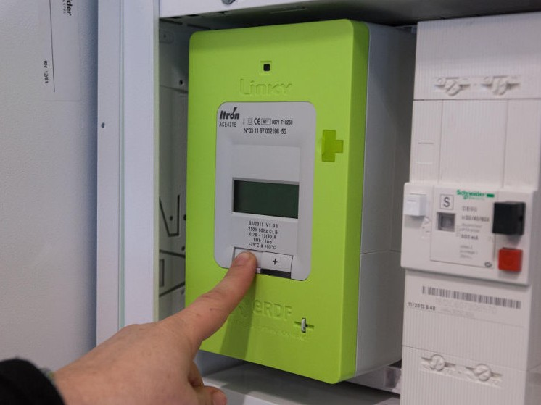

Slide 56
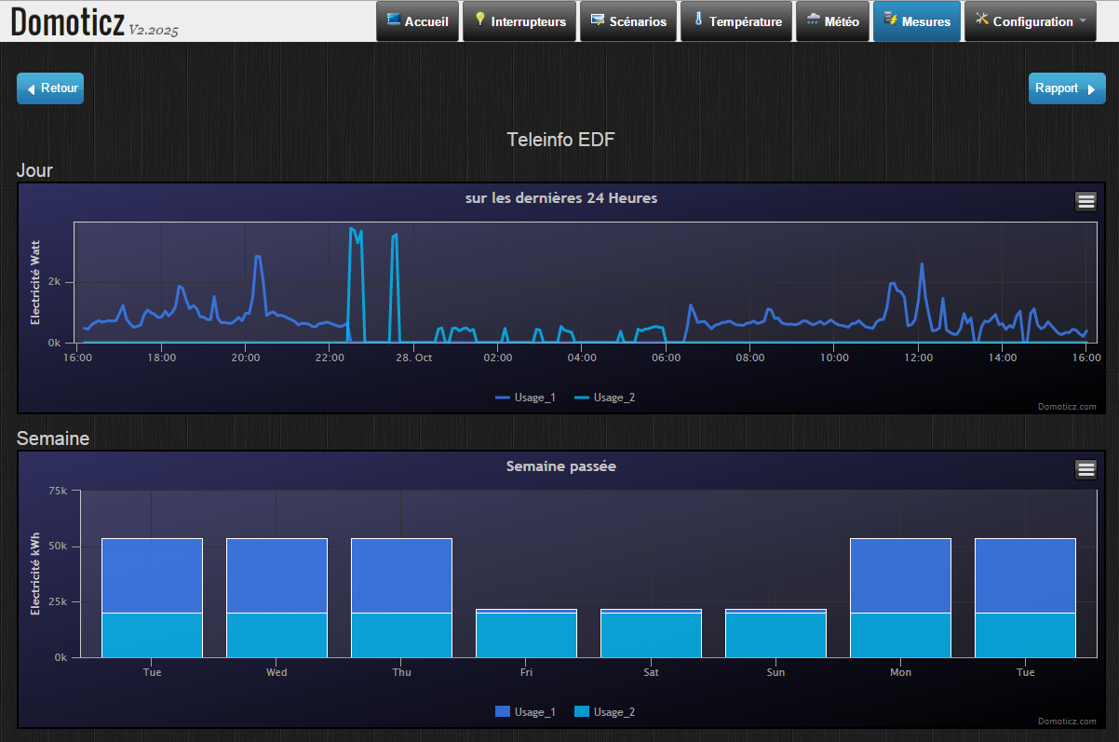

Slide 57
DEMO
enfin !

Slide 58
Sensor

Slide 59
Observable sensor =
Observable.interval(1, TimeUnit.MILLISECONDS)
.map(
(time) -> {return device.getData(time);}
);

Slide 60
Observable sensor =
Observable.interval(1, TimeUnit.MILLISECONDS)
.map(
(time) -> {return device.getData(time);}
);

Slide 61
Observable sensor =
Observable.interval(1, TimeUnit.MILLISECONDS)
.map(
(time) -> {return device.getData(time);}
);

Slide 62
Observable sensor =
Observable.interval(1, TimeUnit.MILLISECONDS)
.map(
(time) -> {return device.getData(time);}
);

Slide 63
Observable sensor =
Observable.interval(1, TimeUnit.MILLISECONDS)
.map(
(time) -> {return device.getData(time);}
);
un peu trop rapide…

Slide 64
Observable sensor =
Observable.interval(1, TimeUnit.MILLISECONDS)
.map(
(time) -> {return device.getData(time);}
)
.throttleFirst(150, TimeUnit.MILLISECONDS);

Slide 65
Sensor

Slide 66
Network Emitter

Slide 67
ZMQ.Socket publisher = context.socket(ZMQ.PUB);
publisher.bind("tcp://*:5556");
sensor.forEach(
(value) -> {publisher.send(data, 0);}
)
.subscribe();

Slide 68

ZMQ.Socket publisher = context.socket(ZMQ.PUB);
publisher.bind("tcp://*:5556");
sensor.forEach(
(value) -> {publisher.send(data, 0);}
)
.subscribe();

Slide 69
ZMQ.Socket publisher = context.socket(ZMQ.PUB);
publisher.bind("tcp://*:5556");
sensor.forEach(
(value) -> {publisher.send(data, 0);}
)
.subscribe();

Slide 70
ZMQ.Socket publisher = context.socket(ZMQ.PUB);
publisher.bind("tcp://*:5556");
sensor.forEach(
(value) -> {publisher.send(data, 0);}
)
.subscribe();

Slide 71
ZMQ.Socket publisher = context.socket(ZMQ.PUB);
publisher.bind("tcp://*:5556");
sensor.forEach(
(value) -> {publisher.send(data, 0);}
)
.subscribe();

Slide 72
Network Emitter

Slide 73
Network Receiver

Slide 74
ZMQ.Socket socket = context.socket(ZMQ.SUB);
socket.subscribe(new byte[0]);
socket.connect("tcp://localhost:5556");
Observable receiver = ZeroMQObservables.from(socket)

Slide 75
ZMQ.Socket socket = context.socket(ZMQ.SUB);
socket.subscribe(new byte[0]);
socket.connect("tcp://localhost:5556");
Observable receiver = ZeroMQObservables.from(socket)

Slide 76
ZMQ.Socket socket = context.socket(ZMQ.SUB);
socket.subscribe(new byte[0]);
socket.connect("tcp://localhost:5556");
Observable receiver = ZeroMQObservables.from(socket)

Slide 77
ZMQ.Socket socket = context.socket(ZMQ.SUB);
socket.subscribe(new byte[0]);
socket.connect("tcp://localhost:5556");
Observable receiver = ZeroMQObservables.from(socket)
Fonction perso (12 loc)

Slide 78
Network Receiver

Slide 79
GUI

Slide 80
XYDataset dataset =
new DynamicTimeSeriesCollection(…)
JFreeChart chart =
ChartFactory.createTimeSeriesChart(…, dataset, …);
receiver.
.observeOn(SwingScheduler.getInstance())
.forEach(
(data) -> {dataset.appendData(array);}
)
.subscribe();

Slide 81

XYDataset dataset =
new DynamicTimeSeriesCollection(…)
JFreeChart chart =
ChartFactory.createTimeSeriesChart(…, dataset, …);
receiver.
.observeOn(SwingScheduler.getInstance())
.forEach(
(data) -> {dataset.appendData(array);}
)
.subscribe();

Slide 82
XYDataset dataset =
new DynamicTimeSeriesCollection(…)
JFreeChart chart =
ChartFactory.createTimeSeriesChart(…, dataset, …);
receiver.
.observeOn(SwingScheduler.getInstance())
.forEach(
(data) -> {dataset.appendData(array);}
)
.subscribe();

Slide 83
XYDataset dataset =
new DynamicTimeSeriesCollection(…)
JFreeChart chart =
ChartFactory.createTimeSeriesChart(…, dataset, …);
receiver.
.observeOn(SwingScheduler.getInstance())
.forEach(
(data) -> {dataset.appendData(array);}
)
.subscribe();

Slide 84
XYDataset dataset =
new DynamicTimeSeriesCollection(…)
JFreeChart chart =
ChartFactory.createTimeSeriesChart(…, dataset, …);
receiver.
.observeOn(SwingScheduler.getInstance())
.forEach(
(data) -> {dataset.appendData(array);}
)
.subscribe();

Slide 85

Java Swing ?

Slide 86
Sensor
Network Emitter
Network Receiver
GUI

Slide 87


Sensor
Network Emitter
Network Receiver
GUI

Slide 88
DEMO

Slide 89
Network Receiver

Slide 90
function fromWebSocket(address) {
var ws = new WebSocket(address);
// Handle the data
var osbervable = Rx.Observable.create (function (obs) {
// Handle messages
ws.onmessage = obs.onNext.bind(obs);
ws.onerror = obs.onError.bind(obs);
ws.onclose = obs.onCompleted.bind(obs);
// Return way to unsubscribe
return ws.close.bind(ws);
});
return osbervable;
}

Slide 91
function fromWebSocket(address) {
var ws = new WebSocket(address);
// Handle the data
var osbervable = Rx.Observable.create (function (obs) {
// Handle messages
ws.onmessage = obs.onNext.bind(obs);
ws.onerror = obs.onError.bind(obs);
ws.onclose = obs.onCompleted.bind(obs);
// Return way to unsubscribe
return ws.close.bind(ws);
});
return osbervable;
}

Slide 92
function fromWebSocket(address) {
var ws = new WebSocket(address);
// Handle the data
var osbervable = Rx.Observable.create (function (obs) {
// Handle messages
ws.onmessage = obs.onNext.bind(obs);
ws.onerror = obs.onError.bind(obs);
ws.onclose = obs.onCompleted.bind(obs);
// Return way to unsubscribe
return ws.close.bind(ws);
});
return osbervable;
}

Slide 93
function fromWebSocket(address) {
var ws = new WebSocket(address);
// Handle the data
var osbervable = Rx.Observable.create (function (obs) {
// Handle messages
ws.onmessage = obs.onNext.bind(obs);
ws.onerror = obs.onError.bind(obs);
ws.onclose = obs.onCompleted.bind(obs);
// Return way to unsubscribe
return ws.close.bind(ws);
});
return osbervable;
}

Slide 94
function fromWebSocket(address) {
var ws = new WebSocket(address);
// Handle the data
var osbervable = Rx.Observable.create (function (obs) {
// Handle messages
ws.onmessage = obs.onNext.bind(obs);
ws.onerror = obs.onError.bind(obs);
ws.onclose = obs.onCompleted.bind(obs);
// Return way to unsubscribe
return ws.close.bind(ws);
});
return osbervable;
}

Slide 95
function fromWebSocket(address) {
var ws = new WebSocket(address);
// Handle the data
var osbervable = Rx.Observable.create (function (obs) {
// Handle messages
ws.onmessage = obs.onNext.bind(obs);
ws.onerror = obs.onError.bind(obs);
ws.onclose = obs.onCompleted.bind(obs);
// Return way to unsubscribe
return ws.close.bind(ws);
});
return osbervable;
}

Slide 96
Network Receiver

Slide 97
GUI

Slide 98
fromWebSocket('ws://localhost:8887/')
.throttleFirst(150)
.subscribe(
function (evt) {
var series = chart.series[0];
var x = (new Date()).getTime();
var y = parseFloat(evt.data);
series.addPoint([x,y], true, true);
});

Slide 99
fromWebSocket('ws://localhost:8887/')
.throttleFirst(150)
.subscribe(
function (evt) {
var series = chart.series[0];
var x = (new Date()).getTime();
var y = parseFloat(evt.data);
series.addPoint([x,y], true, true);
});

Slide 100
fromWebSocket('ws://localhost:8887/')
.throttleFirst(150)
.subscribe(
function (evt) {
var series = chart.series[0];
var x = (new Date()).getTime();
var y = parseFloat(evt.data);
series.addPoint([x,y], true, true);
});

Slide 101
fromWebSocket('ws://localhost:8887/')
.throttleFirst(150)
.subscribe(
function (evt) {
var series = chart.series[0];
var x = (new Date()).getTime();
var y = parseFloat(evt.data);
series.addPoint([x,y], true, true);
});

Slide 102
fromWebSocket('ws://localhost:8887/')
.throttleFirst(150)
.subscribe(
function (evt) {
var series = chart.series[0];
var x = (new Date()).getTime();
var y = parseFloat(evt.data);
series.addPoint([x,y], true, true);
});

Slide 103

Dans mon projet ?

Slide 104

C# .NET

Slide 105
Java
C# .NET

Slide 106
JavaScript
Java
C# .NET

Slide 107
JavaScript
Java
C# .NET
Python

Slide 108
JavaScript
Java
C# .NET
Python
C++

Slide 109
JavaScript
Java
C# .NET
Ruby
Python
C++

Slide 110
Scala
JavaScript
Java
C# .NET
Ruby
Python
C++

Slide 111
Scala
JavaScript
Groovy
Java
C# .NET
Ruby
Python
C++

Slide 112
Scala
Clojure
JavaScript
Groovy
Java
C# .NET
Ruby
Python
C++

Slide 113
Scala
Clojure
JavaScript
Groovy
Java
JRuby
C# .NET
Ruby
Python
C++

Slide 114
Scala
Clojure
JavaScript
Groovy
Kotlin
Java
JRuby
C# .NET
Ruby
Python
C++

Slide 115
Scala
Clojure
JavaScript
Groovy
Kotlin
Java
JRuby
C# .NET
Ruby
Unity3D
Python
C++

Slide 116
Scala
Clojure
JavaScript
Groovy
Kotlin
Java
JRuby
Android
C# .NET
Ruby
Unity3D
Python
C++

Slide 117
Scala
Clojure
JavaScript
Groovy
Kotlin
Java
JRuby
Android
C# .NET
Ruby
Netty
Unity3D
Python
C++

Slide 118
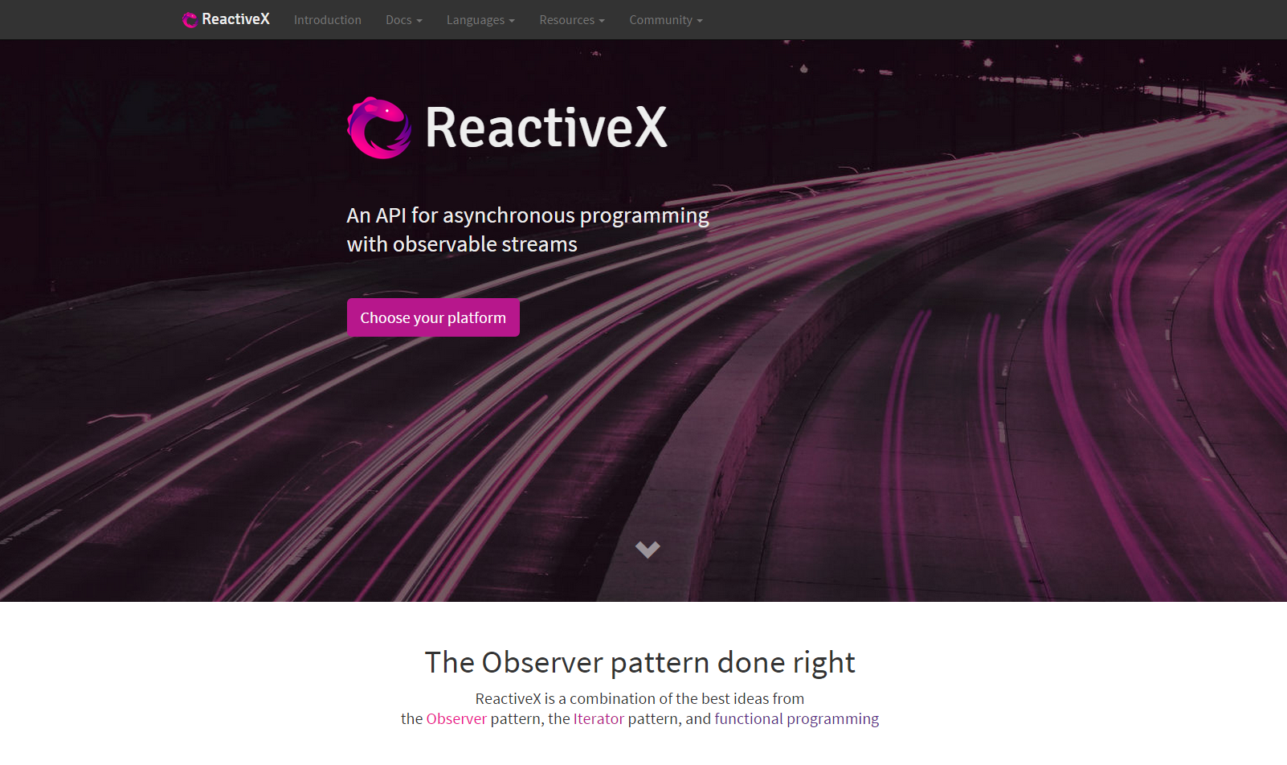

Slide 119
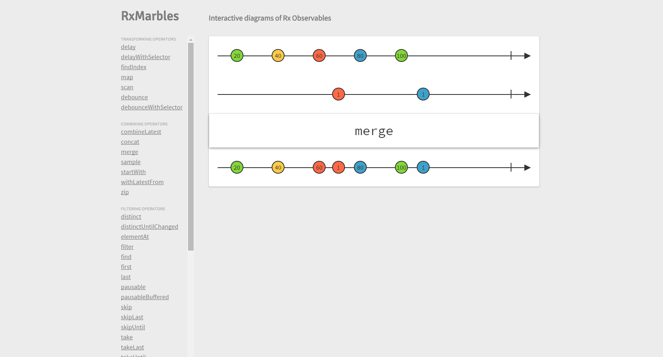

Slide 120
Questions ?

Slide 121
Ressources
http://reactivex.io/
http://rxmarbles.com/
http://jhusain.github.io/learnrx/
https://gist.github.com/staltz/868e7e9bc2a7b8c1f754
http://xgrommx.github.io/rx-book/

Slide 123



2009
Reactive Extensions pour .NET 3.5
2012
Reactive Extensions pour JavaScript
2013
Reactive Extensions pour Java
2013, 2014
Reactive Extensions pour C++, Ruby, Python
nouveau logo

Slide 127
-------------------------------------------------------------------------------------------------------------------

Slide 128
Reactive Extensions

Slide 129
Reactive Extensions

Slide 130
Functionnal Reactive Programming
Retour aux sources
var userChoices =
user.movies.foreach(
S’exécute sur le thread UI

Slide 132


Slide 133


Slide 135


Slide 137


